Slide 1

Stereotypes: Prejudice and Discrimination
AEPSY Year 11 ATAR Psychology

Slide 2
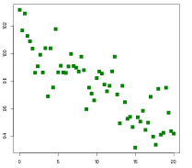
Review
Explain the difference between qualitative and quantitative data, giving examples that relate to psychology.
Estimate the p value of this data:
Define neural blooming and neural
pruning
4. Describe and explain “mid-life crisis”

Slide 3
Learning Intentions
causes of prejudice – social influence, intergroup competition, social categorisation, just world phenomenon

Slide 4
Success Criteria
List causes of prejudice
Define and give examples of social influence, intergroup competition, social categorisation and Just World Phenomenon.

Slide 5
Intergroup Behaviour…
interactions members from one group have with members of another group (also known as intergroup relations).
While social categorisation is an innate process, prejudice develops from environmental influences – it is a learned behaviour.

Slide 6
Social Influence…
Children learn prejudices from their family, teachers, peers and friends. Television, music, movies and social media also reinforce prejudices learned from people around them.
If a social group that an individual seeks to be part of accepts prejudices as the social norm, the individual is motivated to conform to these attitudes, develop the same prejudices and learn the same discriminatory behaviours.

Slide 7
Intergroup competition…
Competition over access to resources, wealth and jobs can lead to groups purposefully inciting prejudice against outgroups by portraying them as a threat.
The chance of prejudice increases when competing groups are of relatively equal status.

Slide 8
An example of prejudice being caused by intergroup competition is the economic threat a social group feels from new immigrants arriving in a country where there is competition to access over jobs.

Slide 9
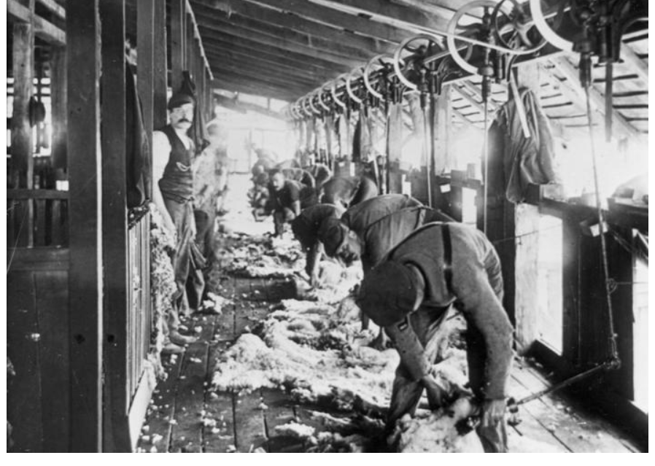
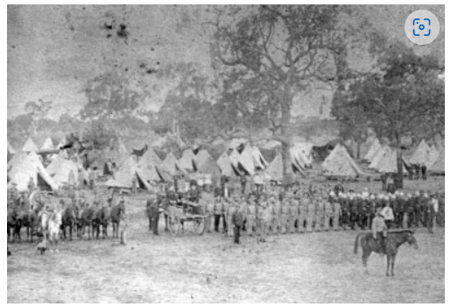
Waltzing Matilda and the White Australia Policy
Banjo Patterson wrote Waltzing Matilda about a shearer who was shot and killed by police during the shearing strikes of the late 1800s-early 1900s. Wealthy pastoralists hired ‘ring in’ Maori shearers to undermine the claims of Australian shearers for better pay and conditions. Unions, including the massive Shearers Union, influenced the White Australia Immigration Policy to prevent “cheap labour” from coming into Australia.

Slide 10
Social Categorisation…
People unconsciously identify individuals that are part of their ingroup, and those that are part of an outgroup.
This process occurs immediately upon contact with a new person and is an important tool that minimises effort required to assess the multitude of characteristics that each person possesses.

Slide 11
Social categorisation is the natural way that humans learn. There is nothing wrong with categorising people into differentiated groups if people keep an open mind to changing categories created (accommodating and assimilation) and to consciously avoid the development of stereotypes and prejudices.

Slide 12
Just World Phenomenon…
the assumption people make that everything happens for a reason and that the world is fair.
Just World Phenomenon is a cognitive bias whereby people make dispositional attributions by blaming victims for misfortunes.
Making dispositional attributions for people who have bad things happen to them leads to negative emotions felt towards them, thus reinforcing prejudices.

Slide 13
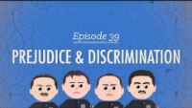

Slide 14
Success Criteria
List causes of prejudice
Define and give examples of social influence, intergroup competition, social categorisation and Just World Phenomenon.

